Slide 1
Spectral Clustering
Kanchan Luitel

Slide 2
Clustering
Group together similar instances
Unsupervised learning – no labels used

Slide 3
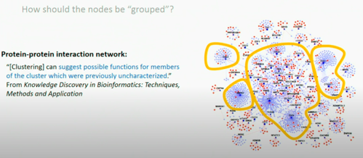
Graph Clustering

Slide 4
Similarity Graphs
Given a set of data points x1, …Xn and some notion of similarity s_{ij} >= 0 between all pairs of data points xi and xj, the intuitive goal of clustering is to divide the data points into several groups such that points in the same group are similar and points in different groups are dissimilar to each other.
Sets as vectors: Measure similarity by the cosine distance
Sets as sets: Measure similarity by the Jaccard distance
Sets as points: Measure similarity by Euclidean distance

Slide 5
Representing Graphs
Definition: Let G = (V, E) be a simple graph with |V| = n. Suppose that the vertices of G are listed in arbitrary order as v₁, v₂, …, v_{n}.
The adjacency matrix A (or A_{G}) of G, with respect to this listing of the vertices, is the n×n zero-one matrix with 1 as its (i, j) entry when v_{i} and v_{j} are adjacent, and 0 otherwise.
In other words, for an adjacency matrix A = [a_{ij}],
a_{ij} = 1 if {v_{i}, v_{j}} is an edge of G, a_{ij} = 0 otherwise.

Slide 6
Adjacency Matrix (A)
a
Vertex
Adjacent Vertices
b
d
a
b, c, d
c
b
a, d
c
a, d
d
a, b, c

Slide 7
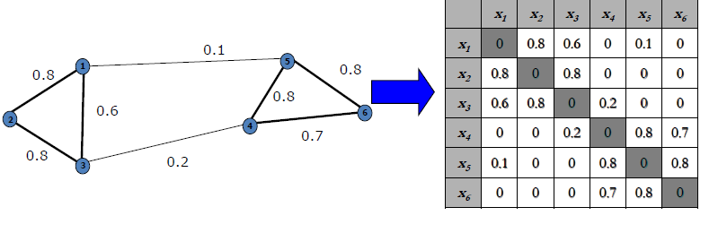
Similarity Matrix (W)

Slide 8
Degree Matrix(D)
a
Vertex
Adjacent Vertices
b
d
a
b, c, d
c
b
a, d
c
a, d
d
a, b, c
3 | 0 | 0 | 0
0 | 2 | 0 | 0
0 | 0 | 2 | 0
0 | 0 | 0 | 3

Slide 9
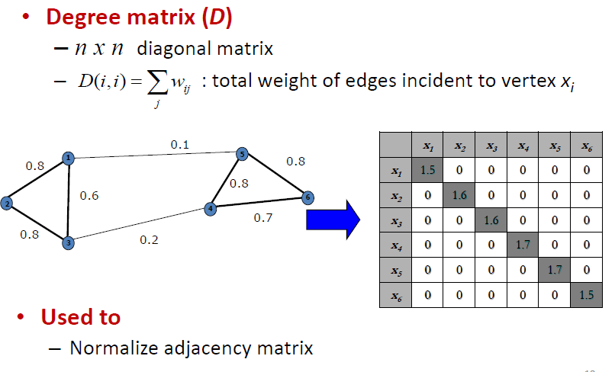
Degree Matrix(D)

Slide 10
Laplacian Matrix (L)
Laplacian Matrix (L) = Degree Matrix(D) – Adjacency Matrix(A)
If weighted graph :
Laplacian Matrix (L) = Degree Matrix(D) – Similarity Matrix (W)

Slide 11
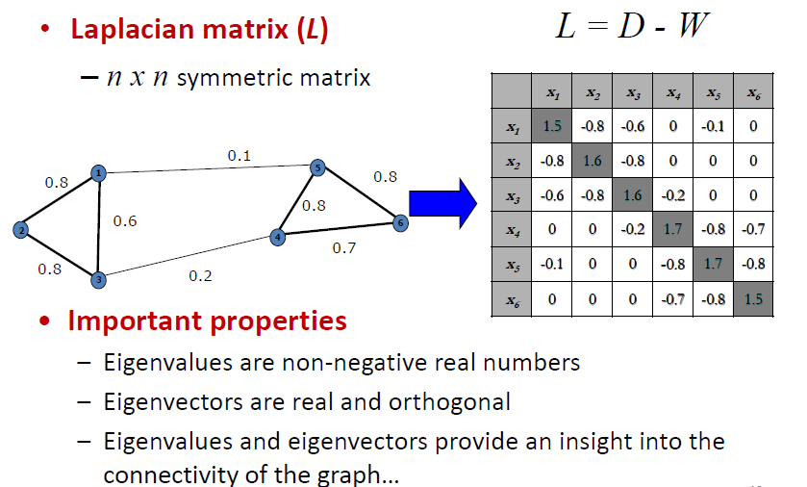
Laplacian Matrix of a Graph

Slide 12
Eigenvalues and Eigenvectors
The eigenvectors x and eigenvalues λ of a matrix A satisfy
Ax = λx
If A is an n x n matrix, then x is an n x 1 vector, and λ is a constant.
The equation can be rewritten as (A - λI) x = 0, where I is the
n x n identity matrix.

Slide 13
Computing Eigenvalues
Since x is required to be nonzero, the eigenvalues must satisfy
det(A - λI) = 0
which is called the characteristic equation. Solving it for values
of λ gives the eigenvalues of matrix A.

Slide 14
Eigenvalue and Eigenvector

Slide 15
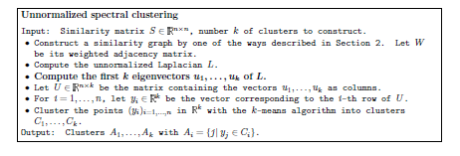
Algorithm

Slide 16
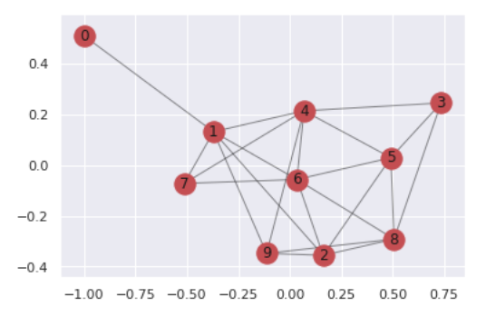
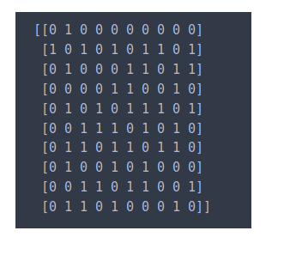
Example

Slide 17
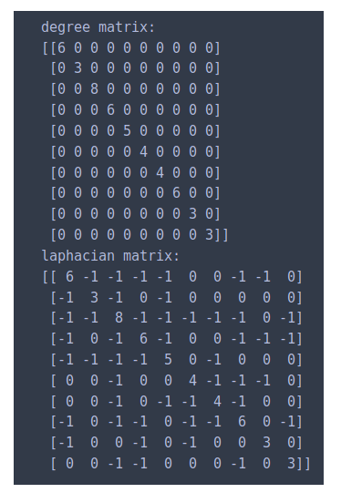
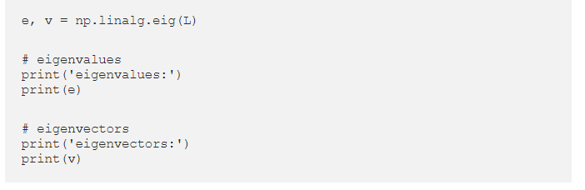
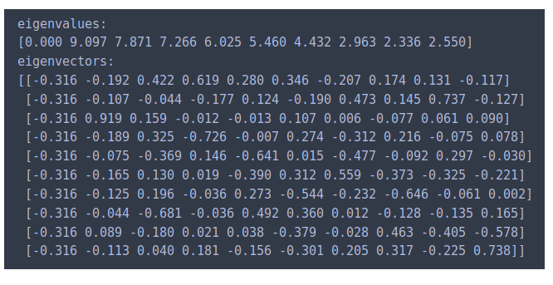
Example

Slide 18
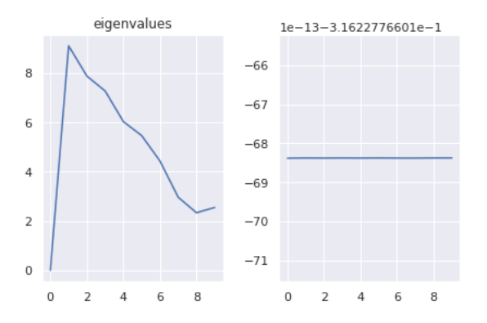

Example

Slide 19
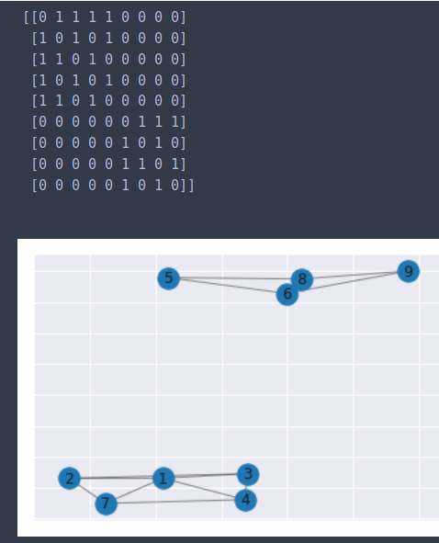
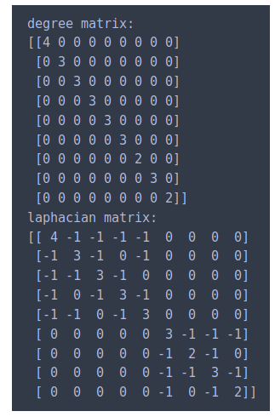
Example

Slide 20
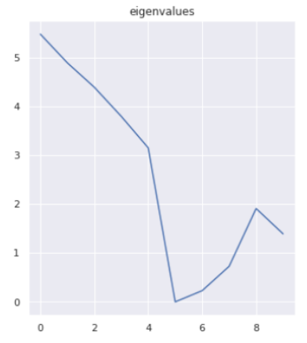
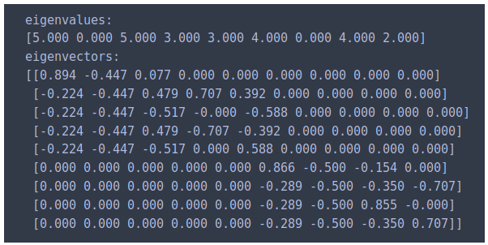
Example

Slide 21
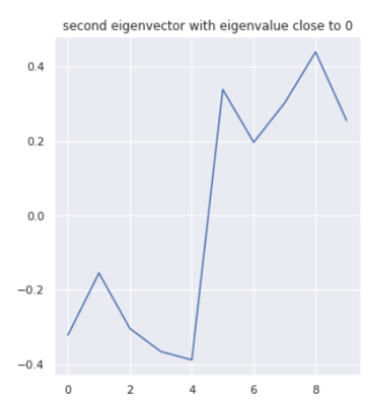
Example

Slide 22
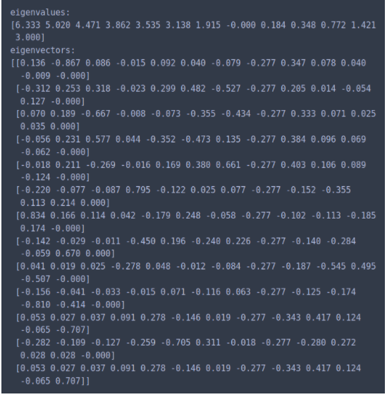
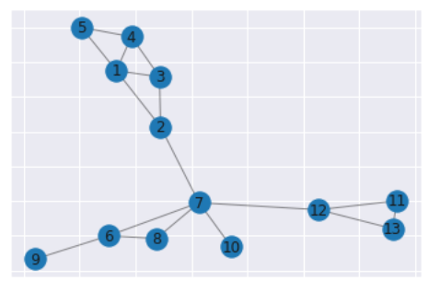
Example

Slide 23
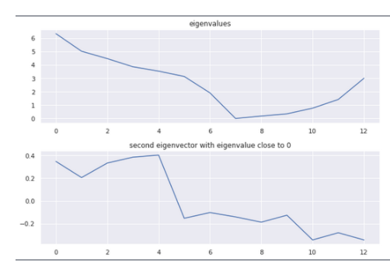
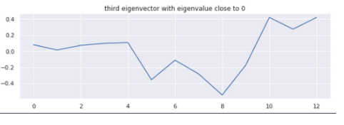
Example

Slide 24
TO DO
Why Laplacian matrix ? How is it connected to Laplacian operator of a function ?
What other options for clustering are available ?
Why it works ?
DEMO ( with code )
Better Mathematical Interpretation
Summarize ongoing research on this topic and what they are trying to achieve
Why use eigenvalue ? How does eigenvalue give the notion of connectedness of the graph ? What is its mathematical interpretation?

Slide 25
TO DO
Unnormalized vs. normalized spectral clustering
Graph cut, ratio cut
Random walks point of view
K means clustering
Programming implementation ( python – jupyter notebook)

Slide 26
References

